Slide 1
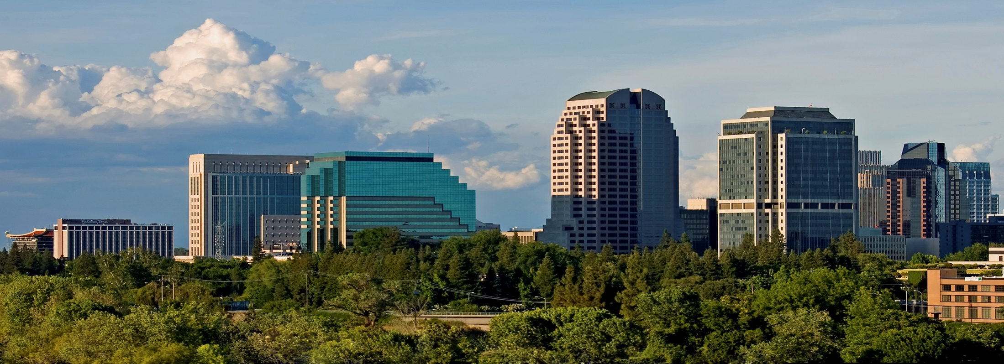
Back to the Basics: Climate and Energy Workshop
The Beacon Program
Karalee Browne

Slide 2
What is the Beacon Program?
The Beacon Program honors local governments’ voluntary efforts to reduce greenhouse gas emissions, save energy and adopt sustainability best practices.
The Beacon Program welcomes cities and counties in all stages of climate action planning and implementation.
It provides a framework to collect data and share best practices that create healthier, more vibrant communities.
The data and stories collected through the program provide valuable information about what local governments are doing to address aggressive state goals related to climate change.
This narrative is important to developing policies that align with the unique opportunities of individual agencies throughout the state so that, together, we all can create a better California.

Slide 3
Beacon Program Participants
New in 2016:
West Hollywood
Emeryville
American Canyon
Whittier
Richmond
Downey
South San Francisco
Mill Valley
The are currently 85 local agencies participating in the Beacon Program, with more joining everyday!

Slide 4
Supporting Disadvantaged Cities
Riverside
West Covina
Chula Vista
Sacramento
National City
Pomona
Rancho
Cucamonga
Carson
Lawndale
South Gate
Indio
Delano
Torrance
Visalia
Redlands
Gardena
Tulare
Patterson
West Sacramento

Slide 5
Beacon Champions Beacon Champions promote and support activities of cities and counties participating in the Beacon Award program

Slide 6
The Roadmap

Slide 7
Get the Recognition you Deserve
Participant Profiles
Videos
Invitations to showcase achievements to a statewide audience
Individualized marketing and recognition plans
Social Media
Western City Magazine Articles
Notes:
Other benefits of participation include…..

Slide 8
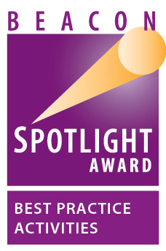
Being in the Spotlight

Slide 9
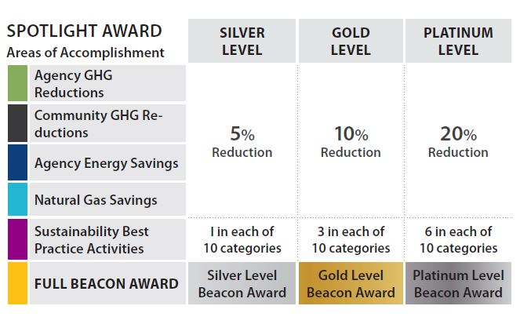
The Levels of Achievement

Slide 10
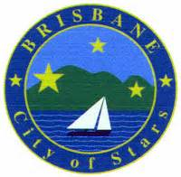
Beacon Award Winners

Slide 11
How to Participate
Complete Simple Online Application
Contact Person
Status of Greenhouse Gas Inventory & Climate Action Plans (Agency & Community)
Adopt a Resolution
Sample resolution & staff report available

Slide 12
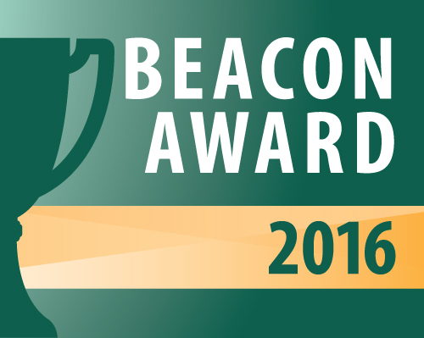
Important Dates
The online application will be available until July 1st.
Applicants will be notified of their award designations by September 1st.
Cities will be honored at the League of California Cities Conference on October 6th at the Hyatt Regency Hotel in Long Beach.
Awards for the winning counties will be given in conjunction with the CSAC Annual Conference in Palm Springs on December 1st.

Slide 13
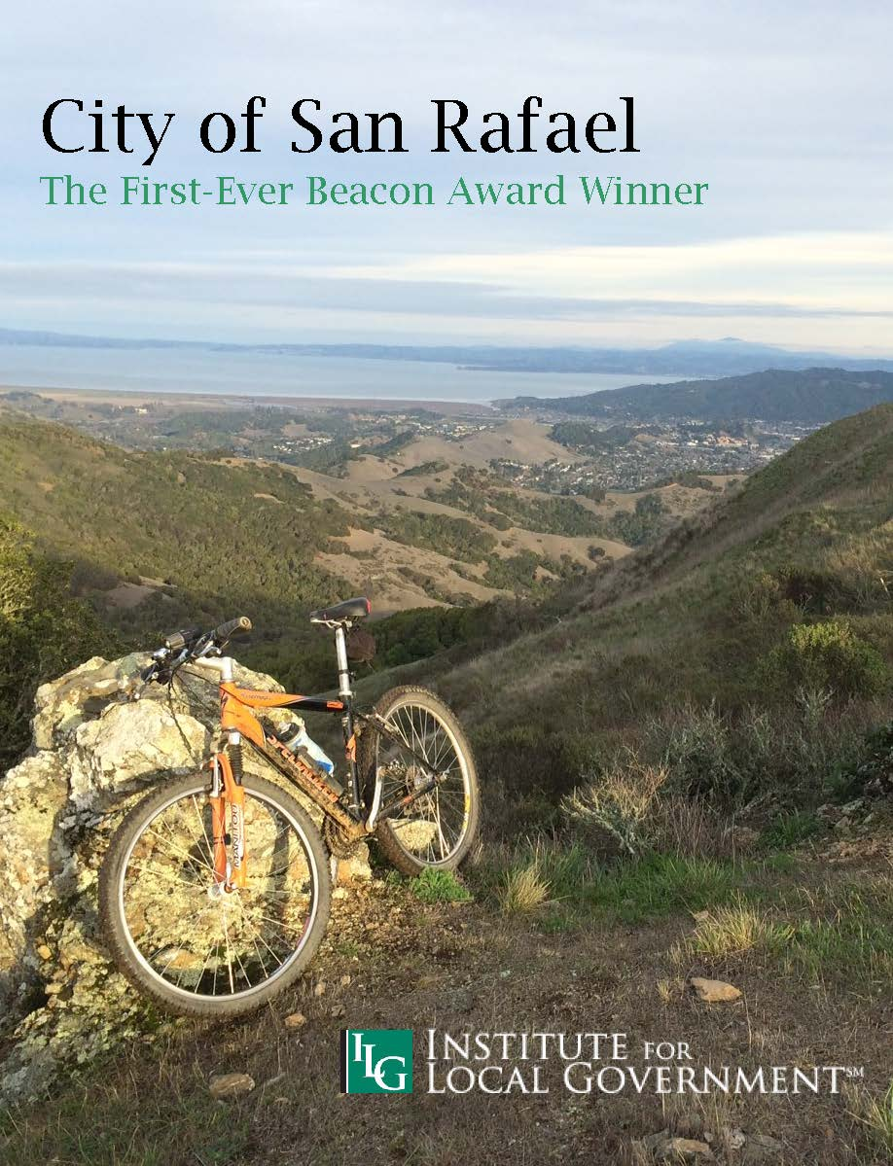
Check Out Our Publications

Slide 14
Beacon Program Contact
Karalee Browne, Program Manager
kbrowne@ca-ilg.org 916-658-8274

